Slide 1
EEN-203 Project
DIGITAL CLOCK

Slide 2
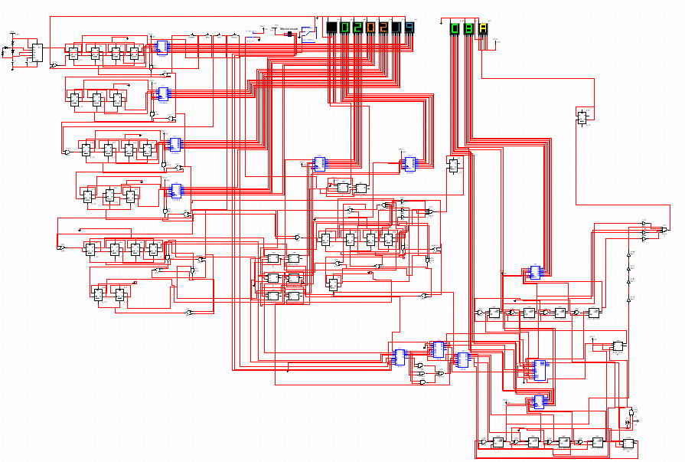
Final Schematic

Slide 3
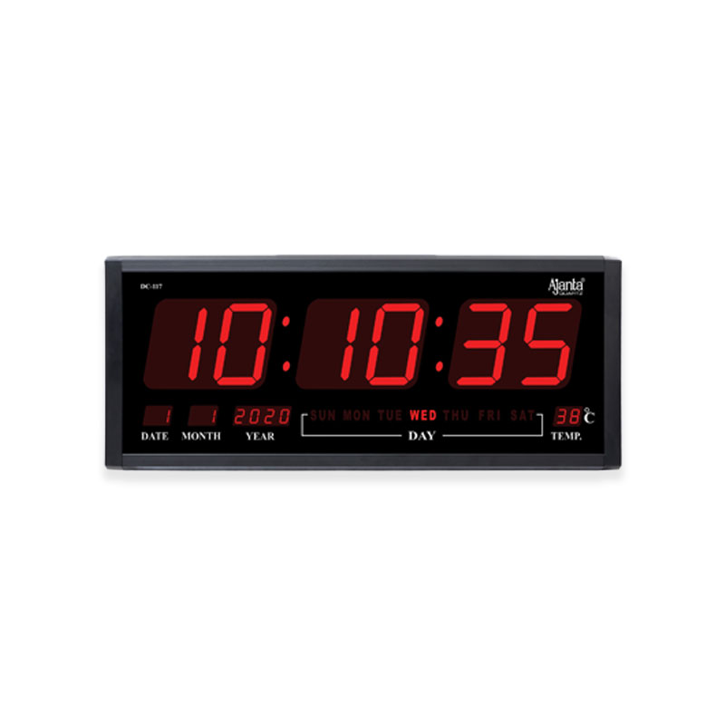
2. Introduction
A digital clock is a clock that displays the time in numerical digits rather than by hands on a dial. It usually consists of three sections namely: hours, minutes and seconds.
Our circuit can be broken down into 3 parts:
1) Generating a pulse of 1Hz using a 555 timer.
2) Making a 1,2,4-bit counter using D flip-flop.
3) Laying out these numbers on 7-segment LED display.
555 timer
Counting
Display
H
M
S
Notes:
555 timer is used to generate a pulse of 1Hz which is the clk input for the d flip flop.

Slide 4
3. Basic functioning and features
12-24 hour display
A switch is used to shift from 12 hour format to 24 hour format. Along with the hour display, the AM/PM display also changes according to the set format.
Stopwatch
A stopwatch starting from 00:00:00 can be synthesized including the feature of hold and reset.
Time Zones
Another interesting feature is that any time zone that is 0-7 hours ahead of the Indian Standard Time can also be displayed in 12 hour format.
Time Adjustment
Three additional push buttons allow the user to increment/ adjust the values of hour, minute or second one at a time.

Slide 5
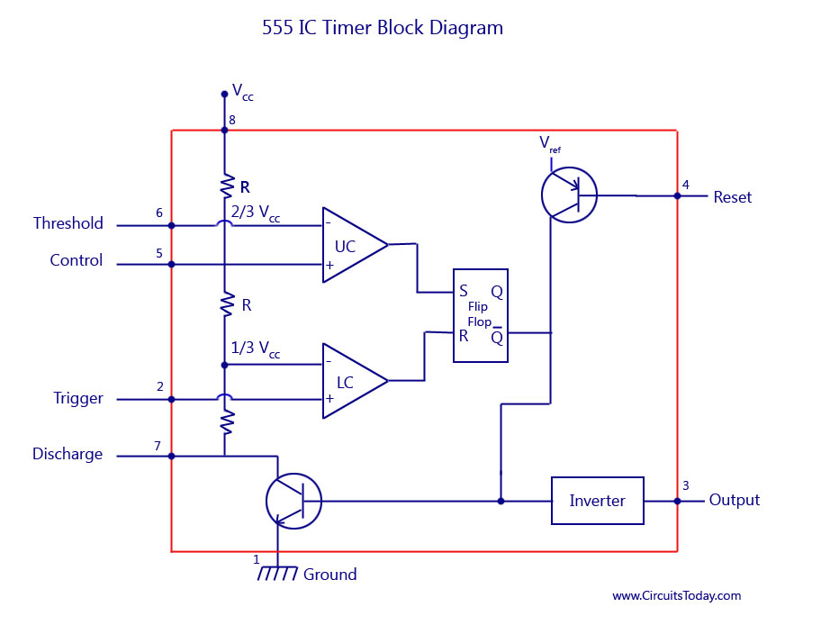
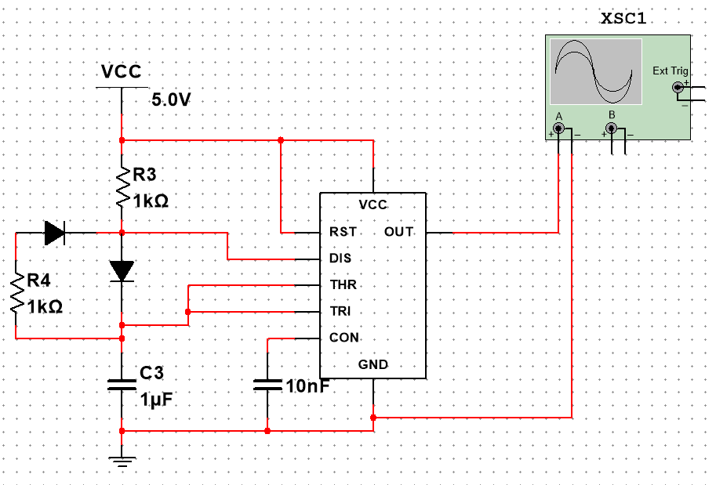
4. 555 Timer
We have simulated the 555 timer in astable mode.
Within the the Timer IC there are two thresholds: 2/3Vcc and 1/3Vcc, which are the inputs to the inverting terminal of first comparator and non-inverting terminal of 2nd comparator respectively.
Initially the capacitor has no charge. It starts charging and the moment it charges to 2/3Vcc, the output of first comparator becomes high and the capacitor starts discharging till its charge reaches 1/3Vcc from where it again starts charging to 2/3Vcc.
The flip flop output toggles between high and low while the capacitor charges and discharges resulting in a pulse.

Slide 6
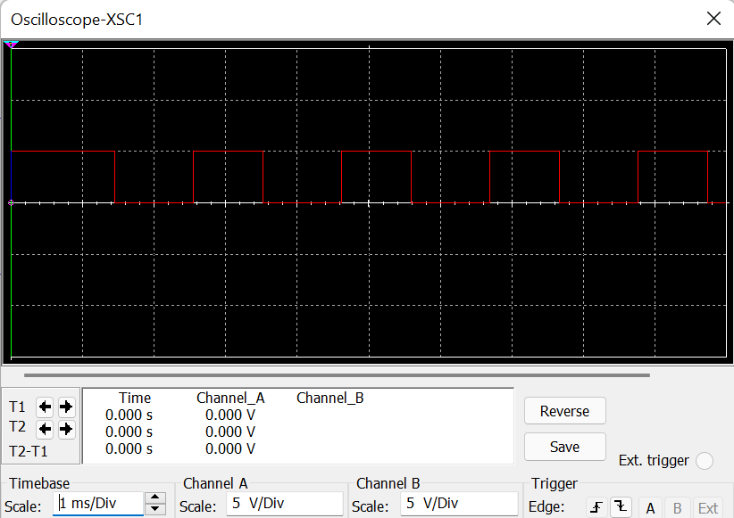
Continued...
In order to get 50% duty cycle we used two diodes.
T_{H}=T_{L}=RCln(2)
So total Time period = 2*RCln(2)
Since we need 1s time period, taking C = 1uF we get R = 721.35kohm
Notes:
We are using two diodes in order to get two different paths for charging and discharging of the capacitor so that we can get 50% duty cycle. But since Multisim cannot be operated in real time we had to reduce the time to microseconds to make the visual time close to 1s. Hence we have set the value of resistors to be equal to 45ohm.

Slide 7
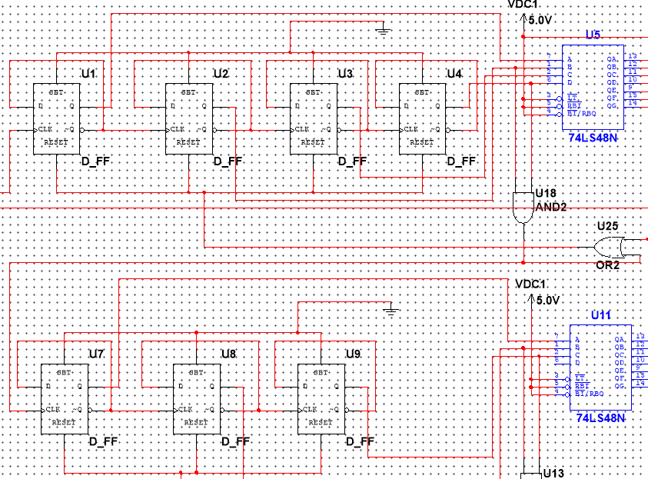
5. Counting using D-FF
In our project we have used positive edge triggered D flip flops with 0 initial condition.
For tracking seconds--
Initially D0=1=Q0’,the moment U1 receives clock high from 555 timer Q0 toggles from 0->1 and the number becomes ‘0001’(1).
Now Q0’=D0=0; at next clk high Q0 changes from 1->0 and Q’=D=1 thus U2 receives clock high and Q1 toggles from 0->1 and the number becomes ‘0010’ (2)likewise the number keeps on incrementing by 1 at the positive edge of 555 timer.
We allow the number in right display of seconds to change from ‘0000’(0) to ‘1001’(9) when the number becomes ‘1010’ we reset U1,U2,U3,U4 to make number ‘0000’(0) in right display.

Slide 8
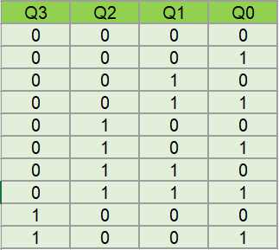
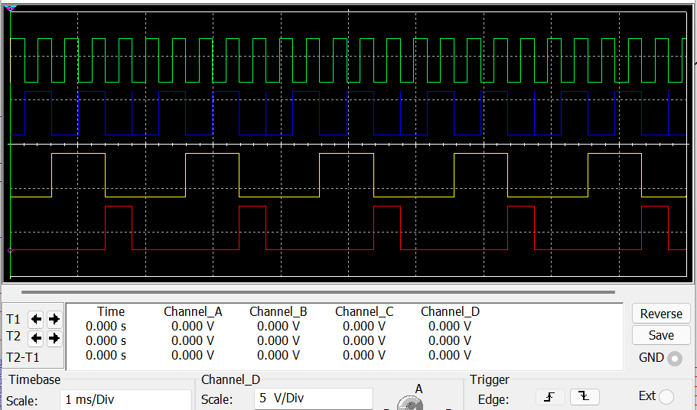
continued...
The combination corresponding to ‘1010’ is fed to clock of U7,this generates instantaneous clk high at transition from 9-10 and Q0 of U7 changes from 0->1 and the number changes from 9-10 then the counting continues upto 59 the moment number entering left display becomes 6 it gives a instantaneous clock high to U14 and minute increases by 1.Similarly when 6 appears in left block of minute hour increments by 1.
For 24 hr clock when number entering left display is 4 and right display is 2 we reset them to 0 0.

Slide 9
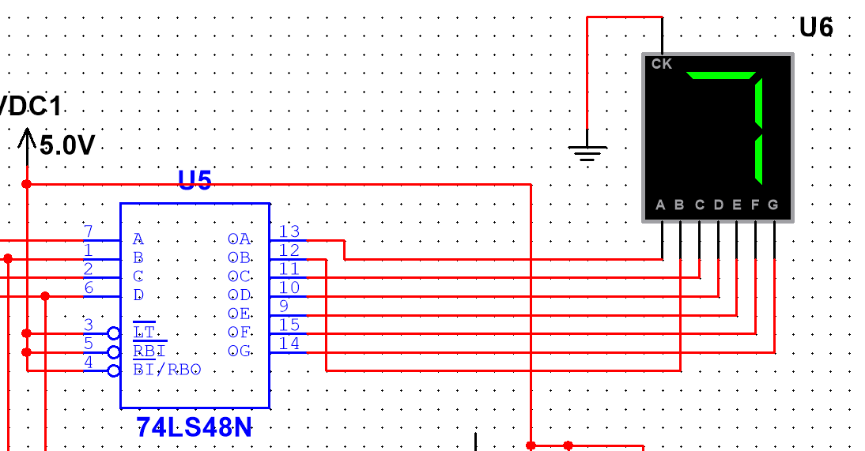
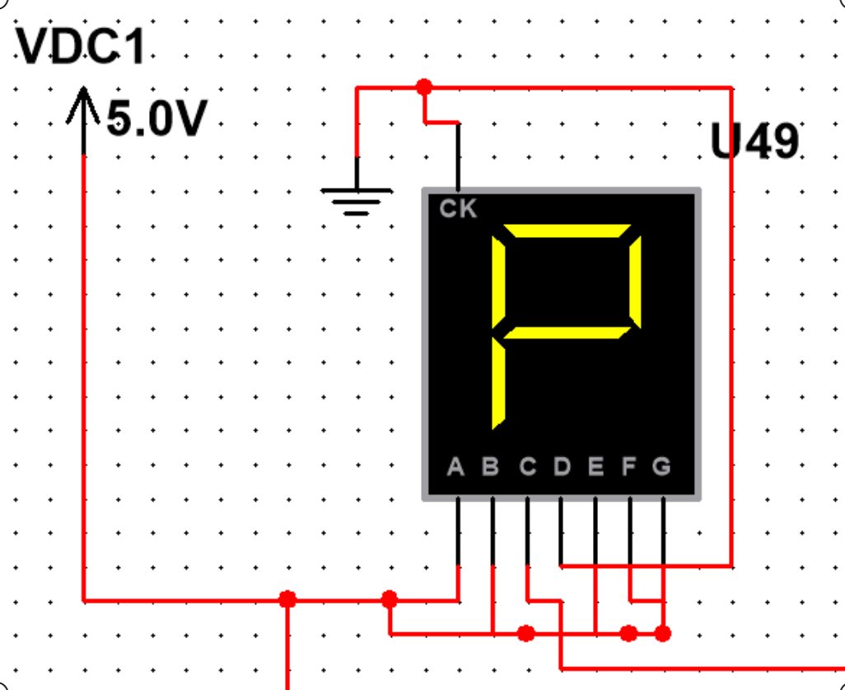
6. Display Block
It is a simple display block for minute, second and hour.
For each digit we send the 4- bit outputs of D Flip Flops to a BCD to 7 segment decoder.
Then we send the outputs of the above IC to a 7-segment display.
For the 12-hour format, we have displayed the AM/PM status as letter A/P on the 7-segment display. For this-A,B,E,F,G are always 1, D is always 0 and C is 1 only when it’s AM and 0 when it is PM.

Slide 10
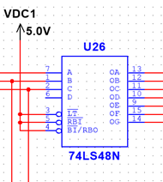
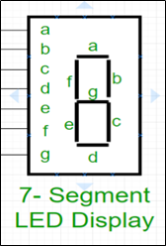
7. BCD to seven segment display IC
BCD to seven segment decoder IC is employed for converting BCD code to seven segment codes.
The BCD output which we get from the counters designed using the D-flip flops is feeded as input to the decoder.
The decoder which we have used in our project is IC 74LS48N.
The figure besides is of IC 74LS48N where ABCD are the BCD inputs with A being LSB, and D being MSB. The seven output lines are connected to the seven-segment display.
The LT’ pin is known as the lamp test pin. It is used to make all the output pins HIGH to test all the 7-segment led. It’s an active low pin.
The RBI’ pin is known as Ripple Blanking Input pin. It is used in case of multiple 7 segments to clear the unnecessary zeros
The BI’ / RBO’ pin acts as a reset pin. In case of LOW state on pin 4, there won’t be any output. It is an active LOW pin; it will make all the output state LOW.

Slide 11
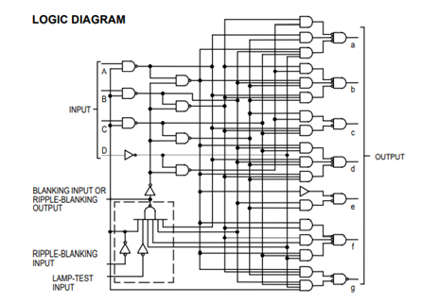
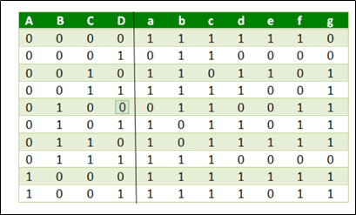
Working of the decoder...
We see for different BCD inputs (i.e., ABCD) different combinations of LEDs represented by (a, b, c, d,……) are turned high giving us the desired display.
Now corresponding to every LED a Boolean expression can be generated using the method of K-Map. The Boolean functions generated are realized using logic gates.
The internal connection for the IC is-

Slide 12
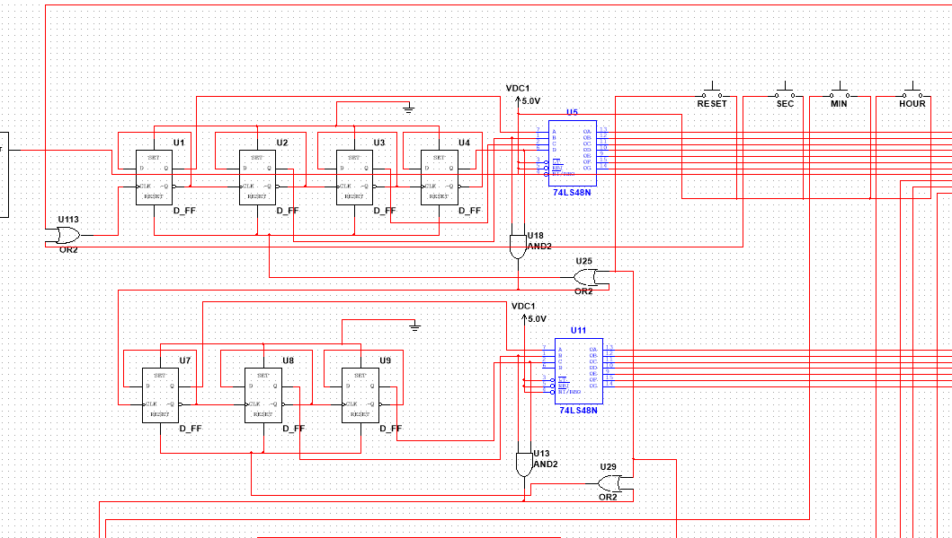
9. Time Adjustment
As evident from the names, these 4 push-buttons are used for adjusting the time.
RESET: when pressed, it resets the 24 hour format to 00:00:00 and 12 hour format to 12:00:00 AM.
SEC: when pressed, it increments the value of second.
The MIN and HOUR push buttons also works in a similar manner.
One end of these push buttons is connected to VCC and the other end should be connected to the clock of the first d flip-flop. However, since now there are two clk inputs, we have used an OR gate to make sure that when either of them is high, the clk receives a pulse.

Slide 13
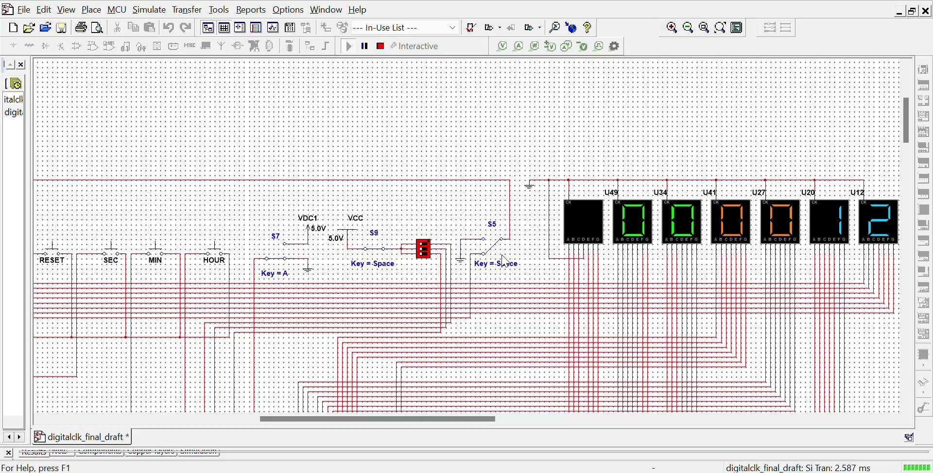
10. Stopwatch

Slide 14
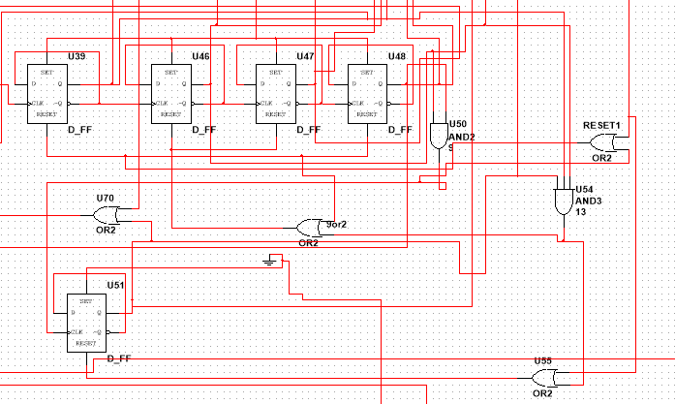
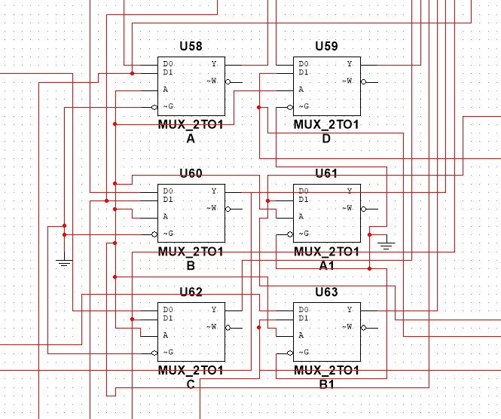
11. 12-24 hour display
In 12-24 conversion, we basically have some changes in flip flop connections corresponding to the hour display.
The clk increments normally upto 12 but when it turns 13 we want to display 01.
So when 13 appears, the right display of hour shows 3 thus output of U39 is 1 and the binary representation as a whole is ’0011’ so to make it 1 we reset other 3 flip flops leaving U39 thus making the representation ‘0001’ and we also reset U51 corresponding to left hour display thus hour segment displays 1 the moment clock strikes 13 and after that the clk increments normally 1->2….->12 and again shifts to 1.
To display AM ,PM we have have used D flip flop with its d terminal connected to Q’ to make it work as toggle flip flop.
Whenever the hour display receives 12 as input the clk input turns high and at its positive edge AM toggles to PM and vice-versa.
After designing the separate ckts we have used 2x1 mux’s to show 24 hr clock or 12 hr clock as per user’s choice.

Slide 15
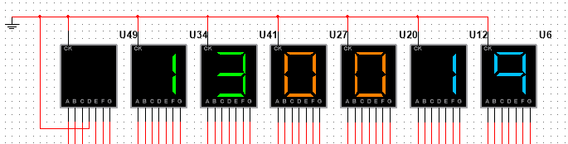
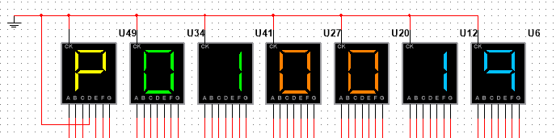
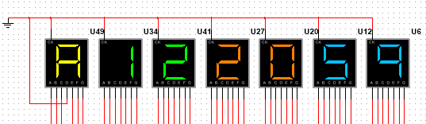
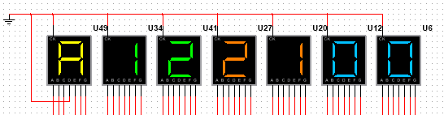
12. Simulation
If we start the clock in 24-hour format and it is 13:00:19 , then on switching it to 12-hour format, it displays 01:00:19 PM as expected.
It is 12:20:59 AM initially, now after 1 second, the minute value increments to 21.

Slide 16
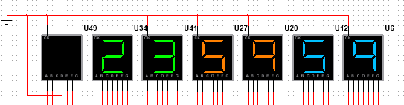
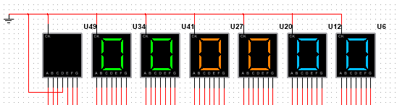
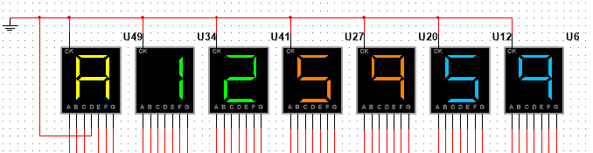
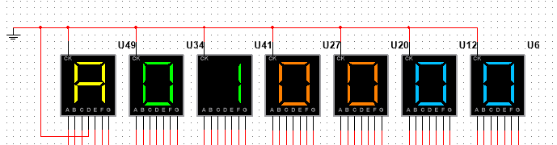
continued...
It is 23:59:59, after 1 second, both the minute and second display reset to 00 which further increments the hour to 00 as per 24 hour format.
Similarly, in the 12 hour format, after 12:59:59 AM, we expect 01:00:00 AM.

Slide 17
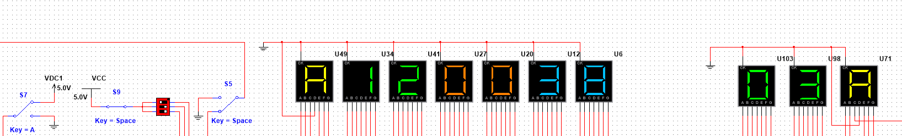
13. Time Zone
Here, we have added a number from 0-7 to the hour display in the 12-hour format. For this, we have used a bcd adder circuit.
Now, the biggest challenge is to make sure that the new displays work according to the 12 hour format.
To solve this problem, the logic used is that whenever the left hour display is equal to 1 and the right hour display is >2 simultaneously, we want to subtract 1 from the left display and 2 from the right display. For example: instead of 17 (12 + 5), we need 05 which can be achieved from the above logic.
Thus, a 4 bit comparator is used for this and whenever the above 2 conditions are fulfilled simultaneously, we have used a binary subtractor to person the necessary subtraction for both the displays.

Slide 18
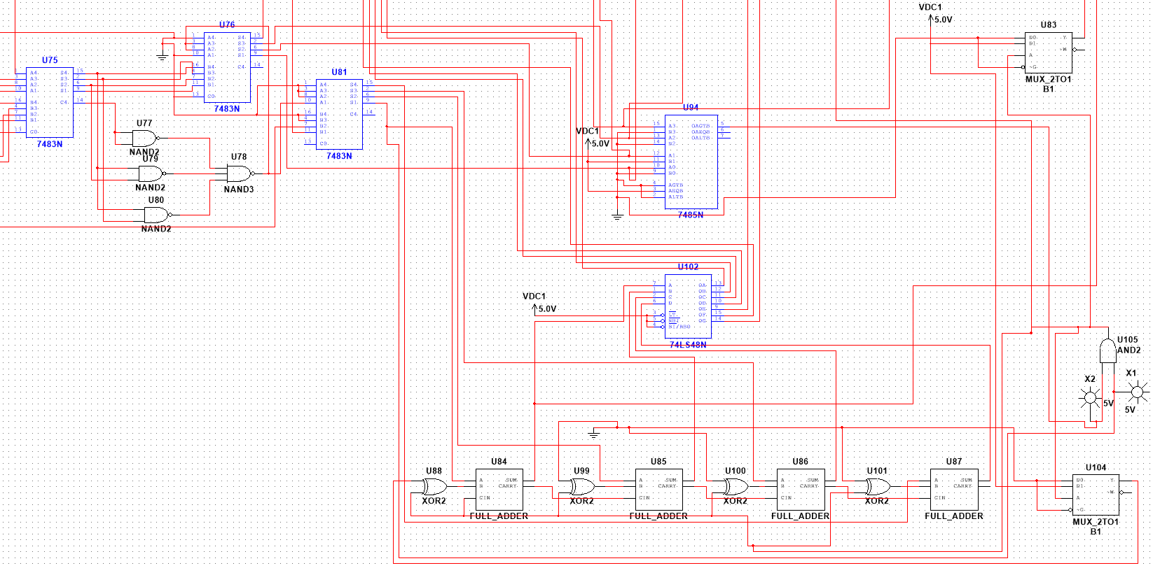

Slide 19
14. References
https://www.mouser.ec/datasheet/2/268/sy10-100el31-278196.pdf
https://www.geeksforgeeks.org/bcd-to-7-segment-decoder/
https://www.youtube.com/watch?v=i0SNb__dkYI
https://pdf1.alldatasheet.com/datasheet-pdf/view/27442/TI/74LS48.html
https://www.ti.com/lit/ds/symlink/sn74lvc2g157.pdf?ts=1636251416990&ref_url=https%253A%252F%252Fwww.google.com%252F

Slide 20
Team Members:
Akriti Jain (20115008)
Amisha Verma (20115012)
Ananya (20115013)
Ananya Sharma (20115014)
Archana Singh (20115019)
Arsh Jindal (20115020)
Borate Srushti Giridhar (20115023)
Disha Agarwal (20115033)
Preeti (20115095)
Priyangsi Dey (20115096)

Slide 21
THANK YOU

